Slide 1

DESIGNING OF MOVIE ticket BOOKING APP
PROJECT SUPERVISOR : Ms. S. POTHUMANI
NAME OF THE STUDENT : MANGADUDDI KISHORE BALAJI
REGISTER NUMBER : 40110722

Slide 2
PRESENTATION OUTLINE
COURSE CERTIFICATE
INTRODUCTION
OBJECTIVES
SYSTEM ARCHITECTURE / IDEATION MAP
MODULE IMPLEMENTATION
APPLICATION SNAPSHOTS
RESULT AND DISCUSSIONS
CONCLUSION & FUTURE WORK
REFERENCES

Slide 3

COURSE CERTIFICATE

Slide 4
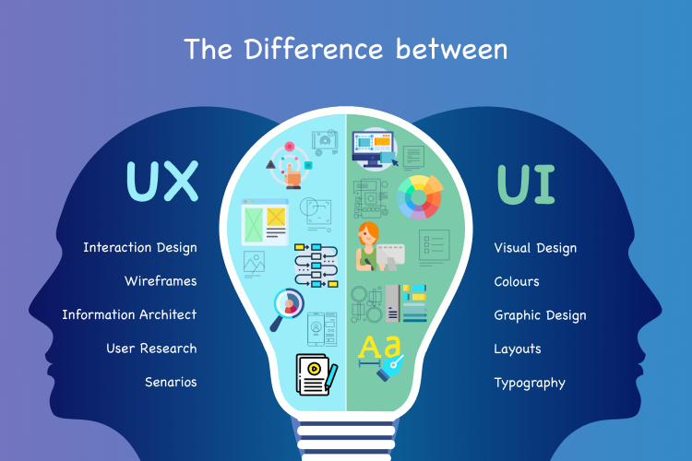
INTRODUCTION
The main aim is to design the movie booking app using Figma platform in UIUX User interface (UI) User experience (UX)
UI refers to the screen ,button ,toggles ,icons and other visual elements
that you interact with when using a website ,app , or other electronic
devices.
UX refers to the entire interaction you have with a product , including
how you feel about the interaction
Having a good UIUX design can help maintain efficiency and create
satisfactory usability results that allow for smooth interactions between
consumers and products or services. Learn more about UI and UX and
how they work together to improve the visible design of a web or mobile
application

Slide 5
OBJECTIVES
When designing a movie booking app, there are several objectives that you may want to consider for a good UI/UX. Some of them are:
Clear and easy navigation: Ensure that users can easily find their way around the app with a clear and intuitive navigation system.
Consistent branding: Use consistent branding elements, such as color scheme and typography, throughout the app to create a unified and memorable user experience.
Simple and straightforward booking process: Make the booking process as simple and straightforward as possible, with clear instructions and minimal steps.
Personalization: Offer personalized recommendations and options based on the user's location, preferences, and past activity.
Easy seat selection: Allow users to easily select their preferred seats in the cinema, with a clear and visually appealing layout.

Slide 6
Secure payment options: Ensure that the app offers secure and reliable payment options, such as credit card or mobile wallet integration.
Accessibility: Make the app accessible to as many users as possible, with features such as text-to-speech and high-contrast mode.
Feedback and support: Provide clear feedback and support options for users who may have questions or issues with the app

Slide 7
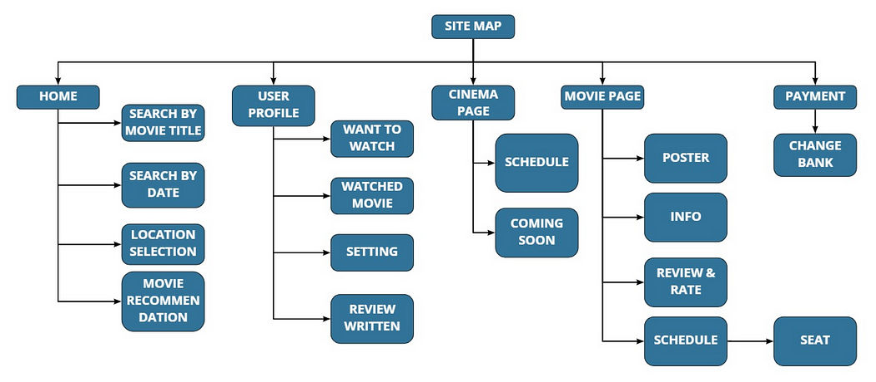
SYSTEM ARCHITECTURE / IDEATION MAP

Slide 8
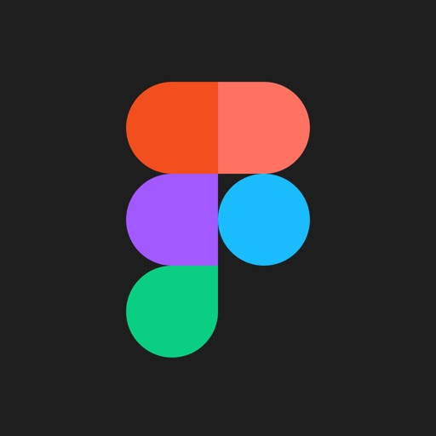
Module implementation
FIGMA
Figma is a web-based graphics editing and user interface design app. You can use it to do all kinds of graphic design work from wire framing websites, designing mobile app interfaces, prototyping designs, crafting social media posts, and everything in between.
Figma is different from other graphics editing tools. Mainly because it
works directly on your browser. This means you get to access your
projects and start designing from any computer or platform without
having to buy multiple licenses or install software.
Figma is a browser-based design software that is used in many contexts,
such as UX design, UI design, and graphic design.
A few examples of UX and UI deliverables that can be designed in Figma
include
WIREFRAME
INTERACTIVE PROTOTYPE
USER FLOW
SITE MAPS
FIGMA

Slide 9
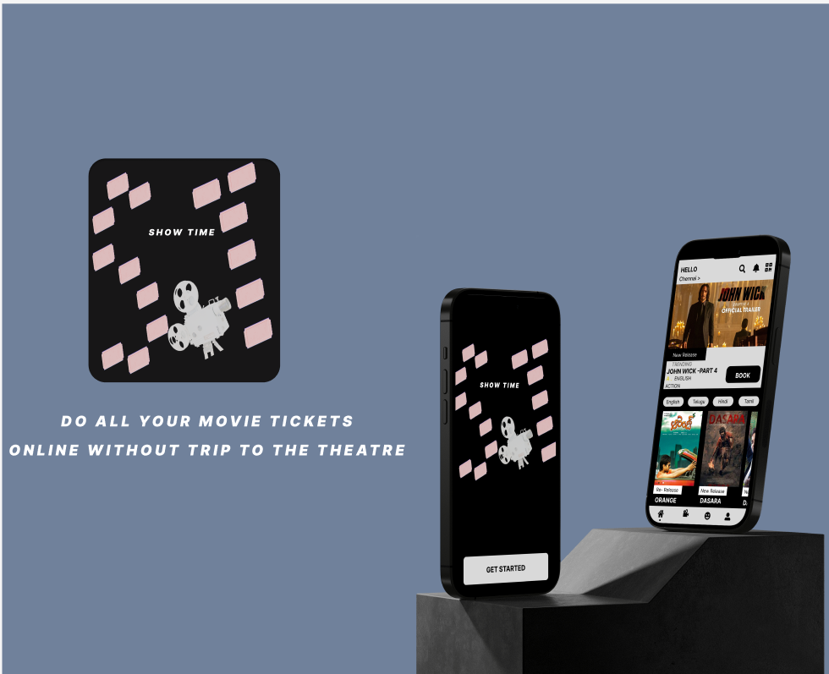
SNAPSHOT

Slide 10
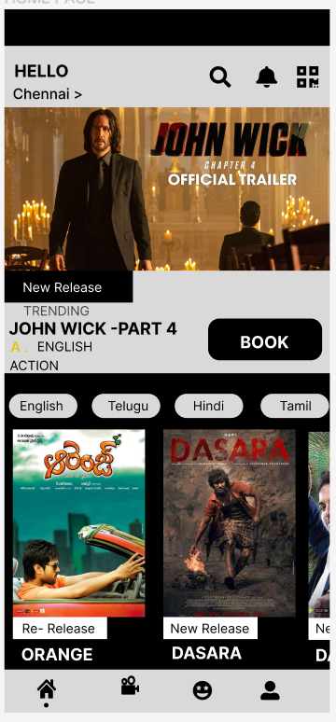
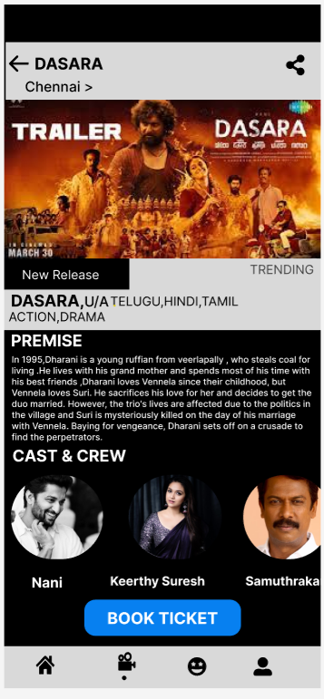
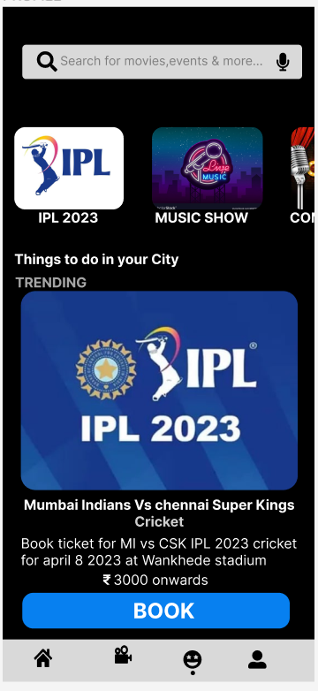
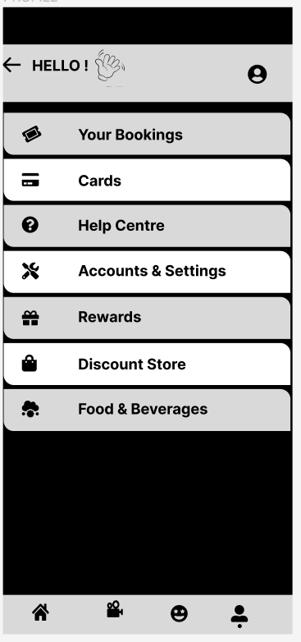

Slide 11
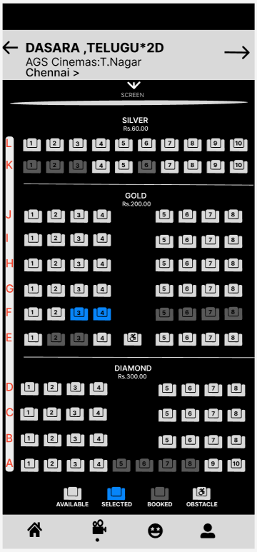
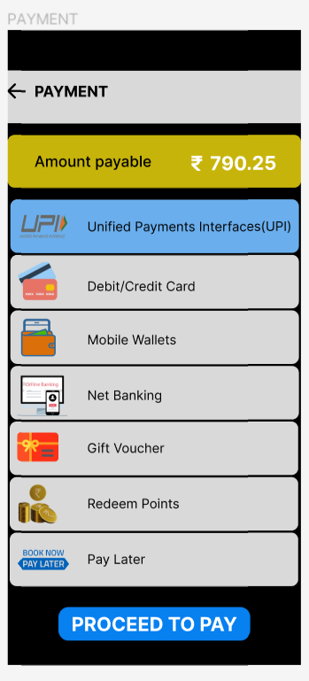
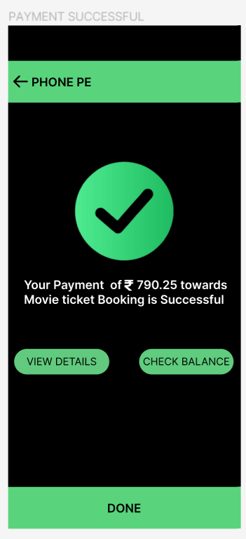
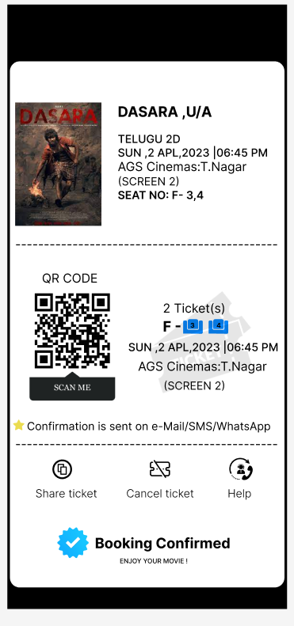

Slide 12
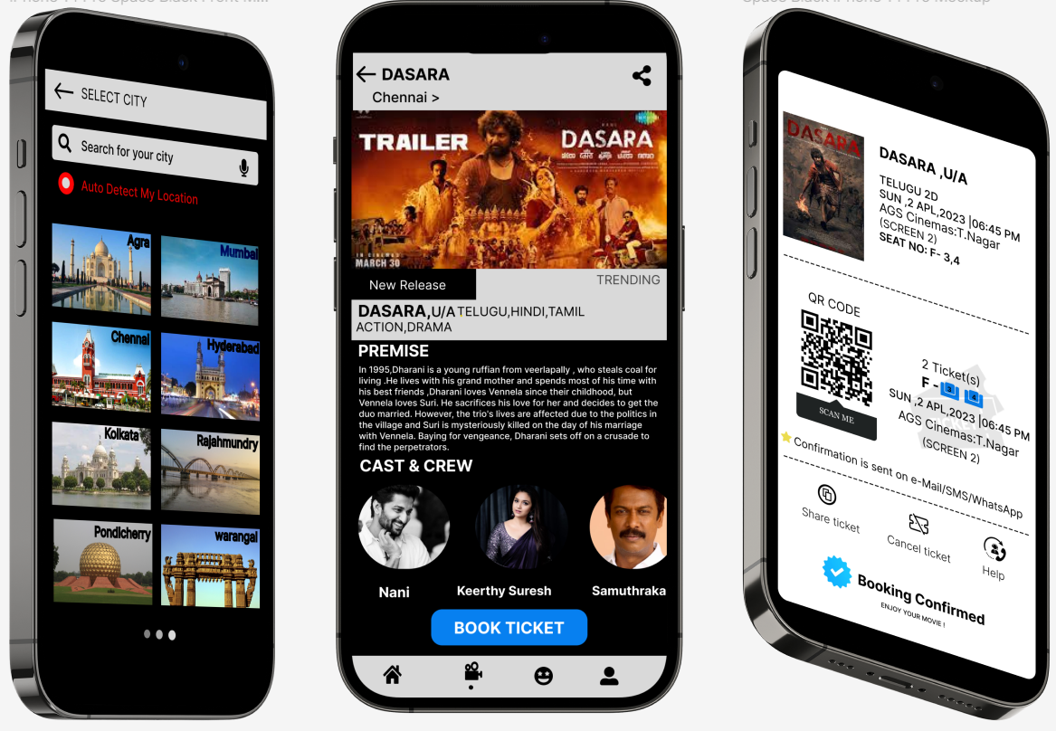

Slide 13
RESULT AND DISCUSSIONS
RESULT : There fore the movie booking application design using figma is successfully completed and I have attached my designing images in this PPT The prototype is also added along with the designing frames
DISCUSSIONS : Let's start by discussing the basic features of a movie booking app and the user interface design considerations for each of these features . Movie selection: The first step in booking a movie is selecting the movie. The UI should have a clear layout for displaying the list of available movies with their ratings, reviews, trailers, and other relevant details. It should be easy to search for movies based on various criteria such as genre, language, and release date . Showtime selection: Once the user has selected a movie, they should be able to see the available showtimes for that movie. The UI should display the showtimes in a clear and concise manner, allowing the user to quickly select the showtime that suits them best. It should also be possible to filter showtimes by theater location or screen size . Seat selection: After selecting the showtime, the user should be able to select the seats they want to book. The UI should display a clear seating chart with available and booked seats clearly marked. It should be easy to select multiple seats and see the total cost of the booking.Payment: The payment process should be simple and secure. The UI should clearly display the payment options and provide a secure payment gateway for the user to make their payment .Confirmation : Once the payment is successful, the user should receive a confirmation message with all the details of their booking, including the movie name, showtime, seat numbers, and total cost.

Slide 14
CONCLUSION
A well-designed movie booking app should be easy to navigate and use, with a user-friendly interface and clear, concise information. The app should be visually appealing and provide a seamless experience for users from start to finish. Key features should include search functionality, easy ticket purchasing, seat selection, and the ability to view movie trailers and reviews. Additionally, it is important to provide clear communication regarding ticket availability, showtimes, and any potential issues that may arise. Overall, a successful movie booking app design will prioritize user experience and satisfaction

Slide 15
REFERENCES
BOOKMYSHOW
https://in.bookmyshow.com/
FIGMA COMMUNITY:
https://www.figma.com/community

Slide 16
THANK YOU

